Slide 1
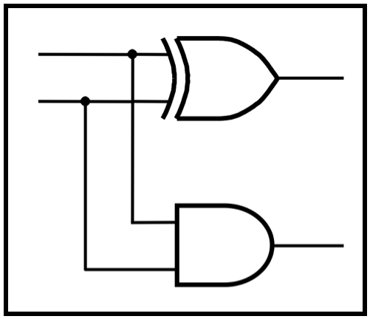
CprE 281:
Digital Logic
Instructor: Alexander Stoytchev
http://www.ece.iastate.edu/~alexs/classes/

Slide 2
Synthesis
Using AND, OR, and NOT Gates
CprE 281: Digital Logic
Iowa State University, Ames, IA
Copyright © Alexander Stoytchev

Slide 3
Administrative Stuff
HW2 is due on Wednesday Sep 7 @ 4pm
Please write clearly on the first page (in block capital letters) the following three things:
  Your First and Last Name
  Your Student ID Number
  Your Lab Section Letter
  Staple all of your pages
If any of these are missing, then you will lose 10% of your grade for that homework.

Slide 4
Administrative Stuff
Next week we will start with Lab2
It will be graded!
Print the answer sheet for that lab and do the prelab at home. Otherwise you’ll lose 20% of your grade for that lab.

Slide 5
Labs Next Week
If your lab is on Mondays, i,e.,
Section N: Mondays, 9:00 - 11:50 am (Coover Hall, room 1318)
Section P: Mondays, 12:10 - 3:00 pm (Coover Hall, room 1318)
Section R: Mondays, 5:10 - 8:00 pm (Coover Hall, room 1318)
You will have 2 labs in one on September 12.
That is, Lab #2 and Lab #3.

Slide 6
Labs Next Week
If your recitation is on Mondays, please go to one of the other 9 recitations next week:
Section U: Tuesday 11:00 AM - 1:50 PM (Coover Hall, room 2050)
Section M: Tuesday 2:10 PM - 5:00 PM (Coover Hall, room 2050)
Section J: Wednesday 8:00 AM - 10:50 AM (Coover Hall, room 2050)
Section T: Wednesday 6:10 PM - 9:00 PM (Coover Hall, room 1318)
Section Q: Thursday 11:00 AM - 1:50 PM (Coover Hall, room 2050)
Section V: Thursday 11:00 AM - 1:50 PM (Coover Hall, room 1318) Section L: Thursday 2:10 PM - 5:00 PM (Coover Hall, room 2050)
Section K: Thursday 5:10 PM - 8:00 PM (Coover Hall, room 2050)
Section G: Friday 11:00 AM - 1:50 PM (Coover Hall, room 2050)
This is only for next week. And only for the recitation (first hour). You won't be able to stay for the lab as the sections are full.

Slide 7
Quick Review

Slide 8
The Three Basic Logic Gates
x
1
x
⋅
x
1
x
x
1
x
2
x
1
+
x
2
x
2
x
2
NOT gate
AND gate
OR gate
[ Figure 2.8 from the textbook ]

Slide 9
Truth Table for NOT
x
x
x
x
0
1
1
0

Slide 10
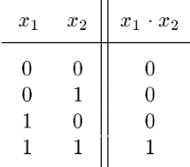
Truth Table for AND
x
1
x
⋅
1
x
2
x
2

Slide 11
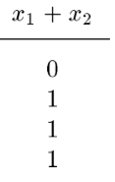
Truth Table for OR
x
1
x
x
1
+
x
2
2

Slide 12








Truth Tables for AND and OR
[ Figure 2.6b from the textbook ]

Slide 13
Operator Precedence
In regular arithmetic and algebra multiplication takes precedence over addition
This is also true in Boolean algebra

Slide 14



Operator Precedence
(three different ways to write the same)

Slide 15
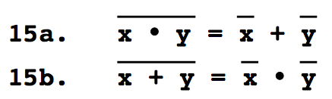
DeMorgan’s Theorem

Slide 16
Function Synthesis

Slide 17
Synthesize the Following Function
x₁ | x₂ | f(x₁,x₂)
0 | 0 | 1
0 | 1 | 1
1 | 0 | 0
1 | 1 | 1

Slide 18
1) Split the function into 4 functions
x₁ | x₂ | f₀₀(x₁,x₂) | f₀₁(x₁,x₂) | f₁₀(x₁,x₂) | f₁₁(x₁,x₂)
0 | 0 | 1 | 0 | 0 | 0
0 | 1 | 0 | 1 | 0 | 0
1 | 0 | 0 | 0 | 0 | 0
1 | 1 | 0 | 0 | 0 | 1

Slide 19
1) Split the function into 4 functions
x₁ | x₂ | f₀₀(x₁,x₂) | f₀₁(x₁,x₂) | f₁₀(x₁,x₂) | f₁₁(x₁,x₂)
0 | 0 | 1 | 0 | 0 | 0
0 | 1 | 0 | 1 | 0 | 0
1 | 0 | 0 | 0 | 0 | 0
1 | 1 | 0 | 0 | 0 | 1

Slide 20




2) Write Expressions for all four
x₁ | x₂ | f₀₀(x₁,x₂) | f₀₁(x₁,x₂) | f₁₀(x₁,x₂) | f₁₁(x₁,x₂)
0 | 0 | 1 | 0 | 0 | 0
0 | 1 | 0 | 1 | 0 | 0
1 | 0 | 0 | 0 | 0 | 0
1 | 1 | 0 | 0 | 0 | 1

Slide 21


3) Then just add them together
x₁ | x₂ | f₀₀(x₁,x₂) | f₀₁(x₁,x₂) | f₁₀(x₁,x₂) | f₁₁(x₁,x₂)
0 | 0 | 1 | 0 | 0 | 0
0 | 1 | 0 | 1 | 0 | 0
1 | 0 | 0 | 0 | 0 | 0
1 | 1 | 0 | 0 | 0 | 1

Slide 23
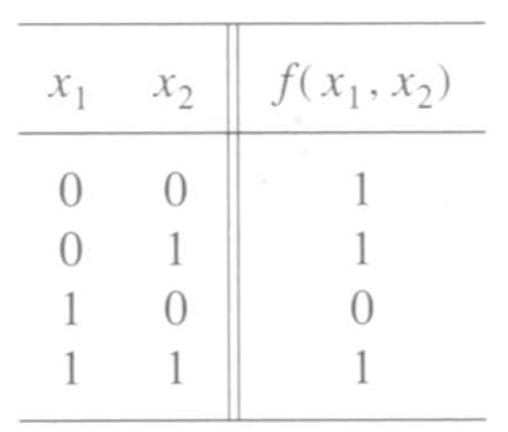
A function to be synthesized
[ Figure 2.19 from the textbook ]

Slide 24
Let’s look at it row by row.
How can we express the last row?

Slide 25
Let’s look at it row by row.
How can we express the last row?

Slide 26
Let’s look at it row by row.
How can we express the last row?
x₁
x₂

Slide 27
What about this row?
x₁
x₂

Slide 28
What about this row?
x₁
x₂

Slide 29
What about this row?
x₁
x₂
x₁
x₂

Slide 30
What about the first row?
x₁
x₂
x₁
x₂

Slide 31
What about the first row?
x₁
x₂
x₁
x₂

Slide 32
What about the first row?
x₁
x₂
x₁
x₂
x₁
x₂

Slide 33
Finally, what about the zero?
x₁
x₂
x₁
x₂
x₁
x₂

Slide 34
Putting it all together
f
x₂
x₁

Slide 35
Let’s verify that this circuit implements correctly the target truth table
f
x₂
x₁

Slide 36
Putting it all together
f
x₂
x₁

Slide 37

Putting it all together
f
x₂
x₁

Slide 38
Canonical Sum-Of-Products (SOP)
x
1
x
2
f
[ Figure 2.20a from the textbook ]

Slide 39
Summary of This Procedure
Get the truth table of the function
Form a product term (AND gate) for each row of the table for which the function is 1
Each product term contains all input variables
In each row, if x_{i} =1 enter it at x_{i} , otherwise use x_{i}
Sum all of these products (OR gate) to get the function

Slide 40
Two implementations for the same function
x
1
x
2
f
(a) Canonical sum-of-products
x
1
x
f
2
(b) Minimal-cost realization
[ Figure 2.20 from the textbook ]

Slide 41

Simplification Steps

Slide 42
Simplification Steps
replicate
this term

Slide 43
Simplification Steps
group
these terms

Slide 44

Simplification Steps
These two terms are trivially equal to 1

Slide 45

Simplification Steps
Drop the 1’s

Slide 46
Minimal-cost realization
x
1
x
f
2
[ Figure 2.20b from the textbook ]

Slide 47
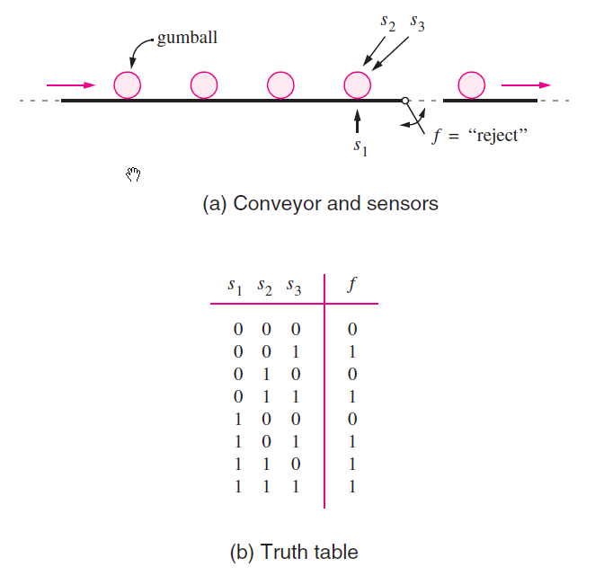
Let’s look at another problem
[ Figure 2.21 from the textbook ]

Slide 48
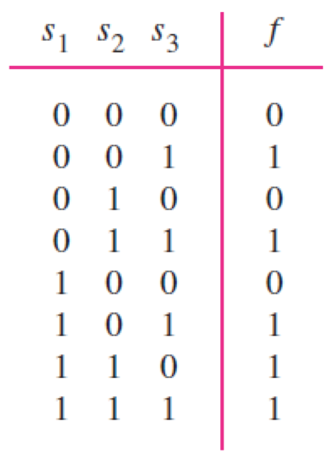
Let’s look at another problem
[ Figure 2.21b from the textbook ]

Slide 49
Let’s look at another problem

Slide 50





Let’s look at another problem

Slide 51
Let’s look at another problem

Slide 52
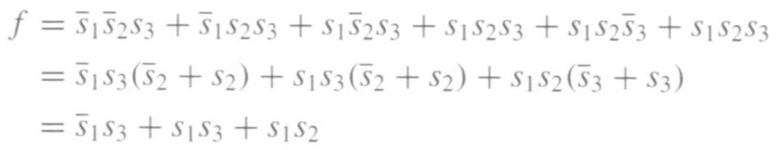

Let’s look at another problem
(minimization)

Slide 53
Let’s look at another problem
(minimization)
s₁
s₂
s₃
f

Slide 54




Minterms and Maxterms

Slide 55
Sum-of-Products Form
f (x₁, x₂)

Slide 56
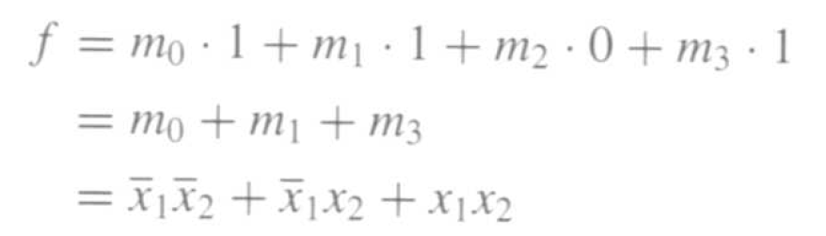
Sum-of-Products Form
f (x₁, x₂)

Slide 58
Product-of-Sums Form
f (x₁, x₂)

Slide 59
Product-of-Sums Form
f (x₁, x₂)

Slide 60
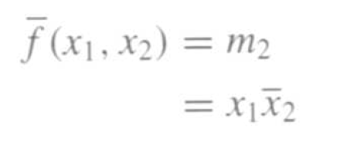
Product-of-Sums Form
f (x₁, x₂)

Slide 61
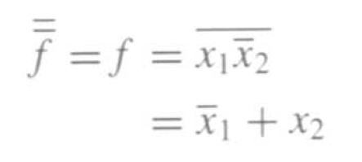
Product-of-Sums Form
f (x₁, x₂)

Slide 62

Product-of-Sums Form
f (x₁, x₂)

Slide 63
Minterms and Maxterms
(with three variables)
[ Figure 2.22 from the textbook ]

Slide 64
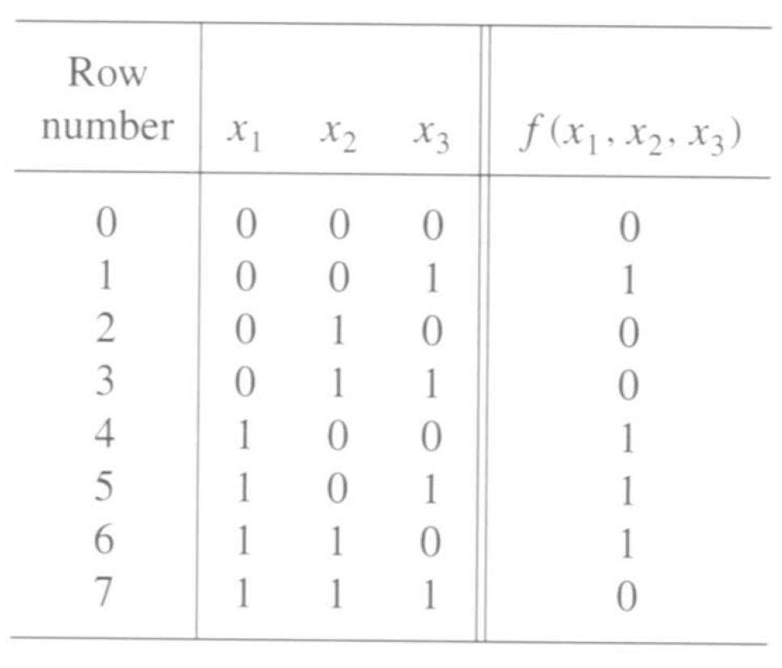
A three-variable function
[ Figure 2.23 from the textbook ]

Slide 65
Sum-of-Products Form

Slide 66
Sum-of-Products Form

Slide 67
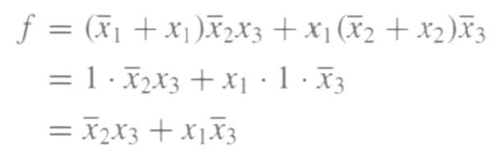
Sum-of-Products Form

Slide 68
A three-variable function
[ Figure 2.23 from the textbook ]

Slide 69
Product-of-Sums Form

Slide 70
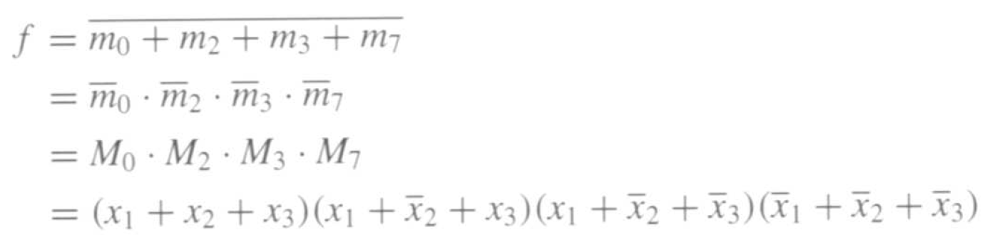
Product-of-Sums Form

Slide 71

Product-of-Sums Form

Slide 72
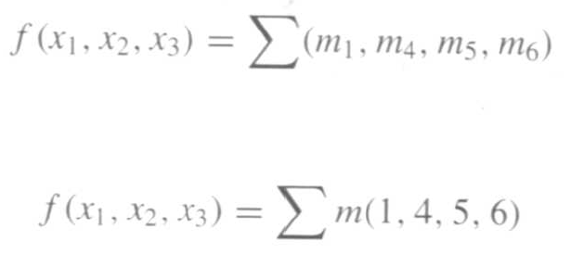
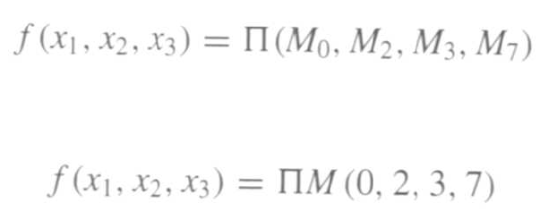
Shorthand Notation
Sum-of-Products
or
Product-of-sums
or

Slide 73
Two realizations of that function
x
2
f
x
3
x
1
(a) A minimal sum-of-products realization
x
1
x
3
f
x
2
(b) A minimal product-of-sums realization
[ Figure 2.24 from the textbook ]

Slide 74
The Cost of a Circuit
Count all gates
Count all inputs/wires to the gates

Slide 75
What is the cost of each circuit?
x
2
f
x
3
x
1
(a) A minimal sum-of-products realization
x
1
x
3
f
x
2
(b) A minimal product-of-sums realization
[ Figure 2.24 from the textbook ]

Slide 76
What is the cost of this circuit?
x
1
x
2
f

Slide 77
Questions?

Slide 78
THE END

